Slide 1
Problems

Slide 2
Types of Computer
There are many different types of computer:
general purpose - PCs, Laptops etc
specialised - servers, routers,microcontrollers

Slide 3
Functions
In general computers can do four things:
Input (accepts data)
Processing (processes data)
Output (produces output)
Storage (save results)

Slide 4
Example
Using one specific computing device (i.e. your smart phone) give examples of these four functions in action:
Type of Computer:
1.Downloading an app
2.The process of sending a text
3.Sounds to Headphones
4.The SD memory cards/ SSD Drive

Slide 5
Why Computers?
What advantages/disadvantages are there when using a computer for a task, compared to a human?
(list as many reasons as you can)
a Computer can handle numbers a lot quicker than a human can.
A computer can do a repetitive task extremely quickly.
A human can do easy tasks without massive amounts of coding.
A computer will not complain.
A human does not need software or coding to operate.

Slide 6
List some Apps that are used for...
Storing of information
Cloud storage apps.
Gmail.

Slide 7
List some Apps that are used for...
Retrieving information
Gmail client
Facebook

Slide 8
List some Apps that are used for...
Sending or communicating information
Skype
Gmail
Messenger
Viber

Slide 9
List some Apps that are used for...
Modifying or transforming information.
Photo editing apps
file converter
Emulator

Slide 10
Hardware/Software
What is the difference between hardware and software?
Hardware is the physical items we see e.g: monitor and tower
software are the programmes on the computer e.g. Microsoft Word.

Slide 11
What are the following for?
CPU- processing the information
GPU-used to create images from the data
RAM- memory used to perform the action
Motherboard- the central hub for the components
Hard Drive-Where the data is stored on a computer.

Slide 12
Software I
What is an operating system (OS) ? List some variants.
Linux
Windows
Macintosh

Slide 13
Software II
In relation to computer software, what are drivers?
Drivers are hardware-dependent and operating-system-specific. They usually provide the interrupt handling required for any necessary asynchronous time-dependent hardware interface
it allows hardware to be used without the specific knowledge of the hardware being used.

Slide 14
Networks
What do computer networks allow us to do?
To send information between specific computers
What is the difference between the world wide web (www) and the internet? the www is documents accessed via the internet

Slide 15
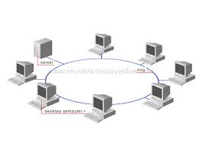
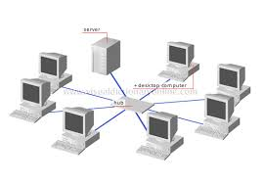
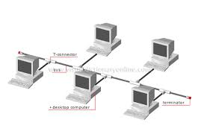
Network Topologies
What do the following network configurations look like?
Ring
Star
Bus
Which configuration do you think this lab uses?
Star

Slide 16
Acronyms
Explain:
LAN- Local Area Network
WAN- wide area network
MAN-metropolitan area network

Slide 17
Protocols
A protocol is simply an agreed way of doing things. For instance, social protocol dictates that if someone greets you with “Dia duit” you reply with “Dia is Muire duit”
Computers have similar - albeit more robust - communication protocols.

Slide 18
What are these Protocols for?
SMTP/POP3: download emails to the client
FTP:transfer files from one host to another
TCP/IP:Connects hosts to the internet

